Slide 2
Data exploration
Outliers in x and y and x~y
Relationships between x variables
Relationships between x and y variables
Interactions - are any apparent and is there enough data to test for them?
Independence
Homogeneity and balance across factor levels and two-way factor-level combinations
Occurrence of zeros and NAs

Slide 3
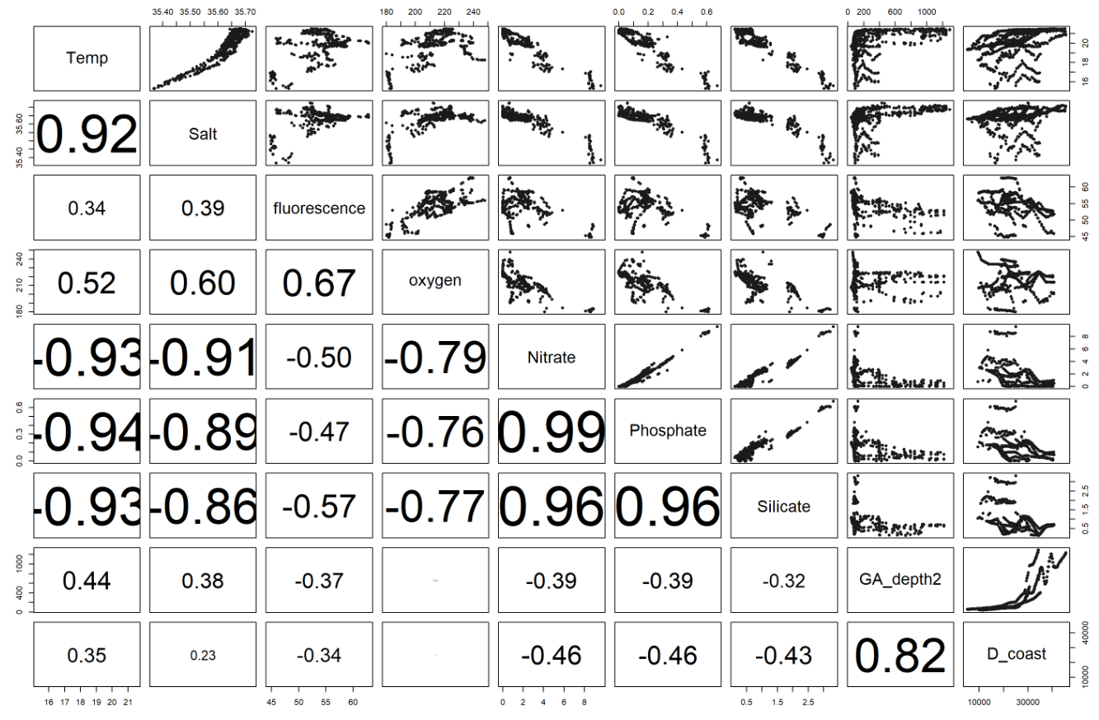

Slide 4
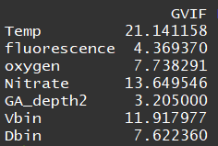
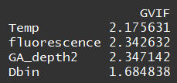
Variance inflation factors
i.e. is a measure for how easily an x-variable is predicted from a linear regression using the other x-variables.
Should be <3
Removing oxygen, Vbin, nitrate

Slide 5
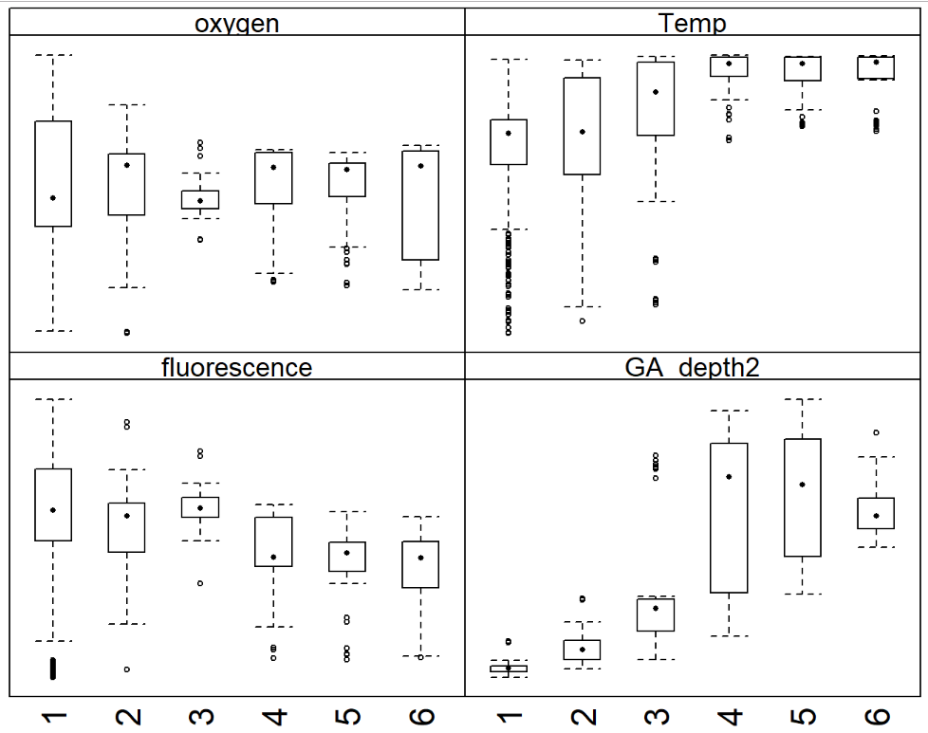
Remove seafloor slope
Seafloor slope

Slide 6
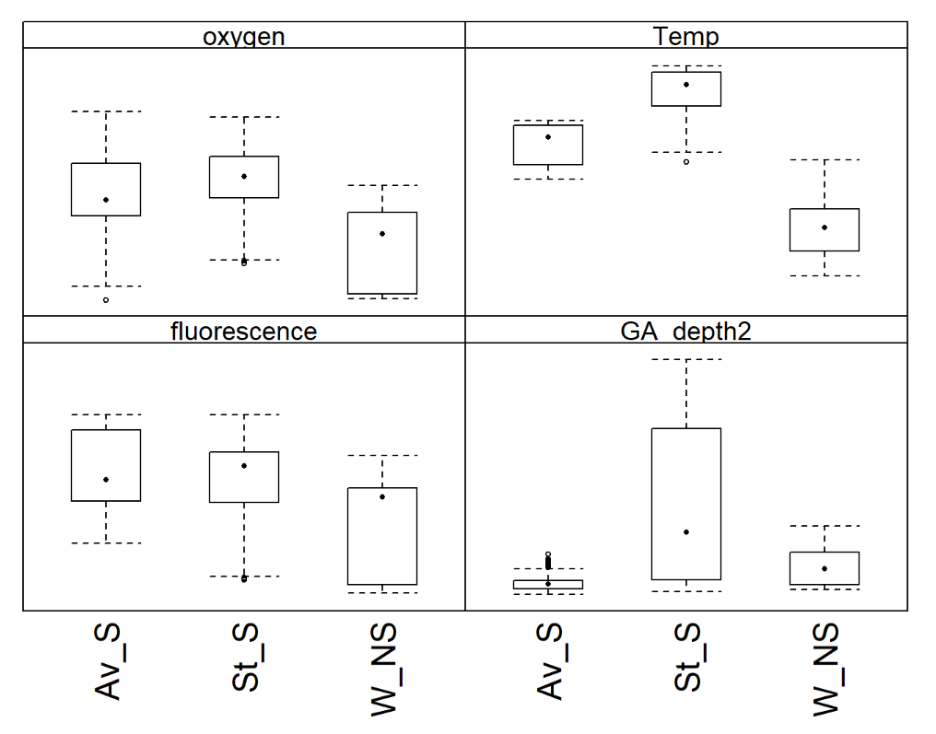
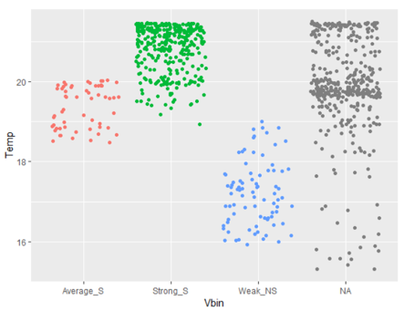
Remove Vbin (more reason to, plus the NAs)
and removal influences temperature effect…

Slide 7
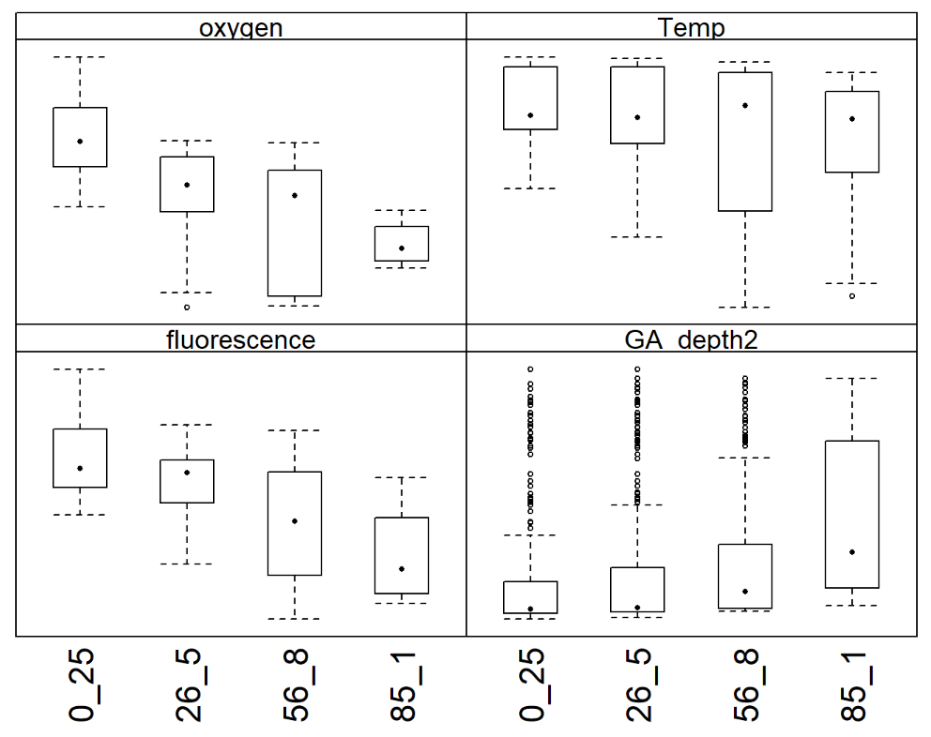
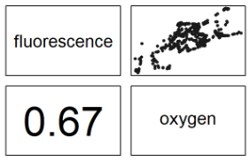
Removing oxygen (more indication)

Slide 8
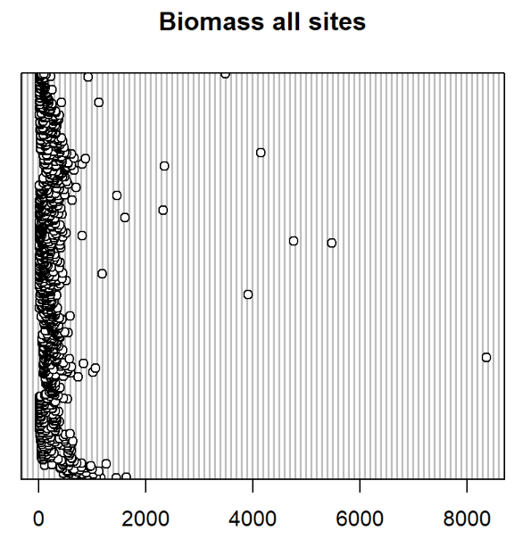
Outliers in y

Slide 9
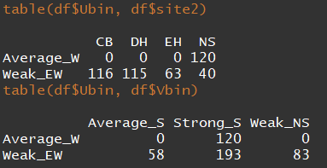
Balance across factor levels
All levels do have enough observations (10-15). Hence they are balanced in one dimension.
However, there are some issues here in the two-way combos:
Ubin is entirely determinable by site
Ubin can be determined based on Vbin and vice versa.

Slide 10
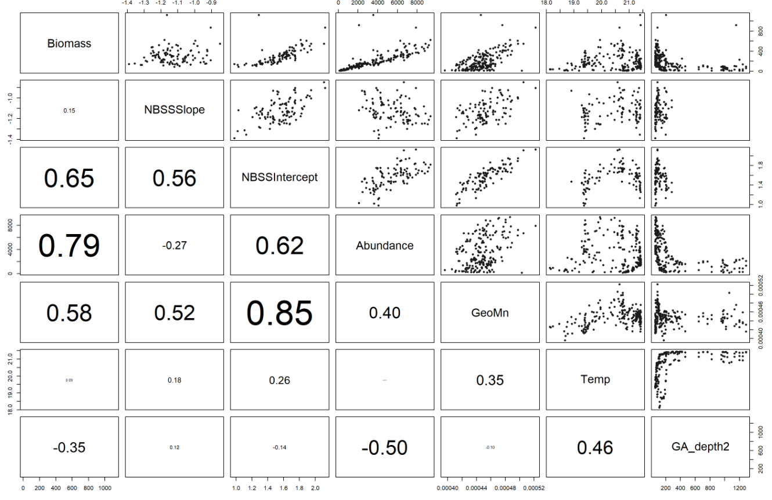
Relationships with y variables @ CB

Slide 11
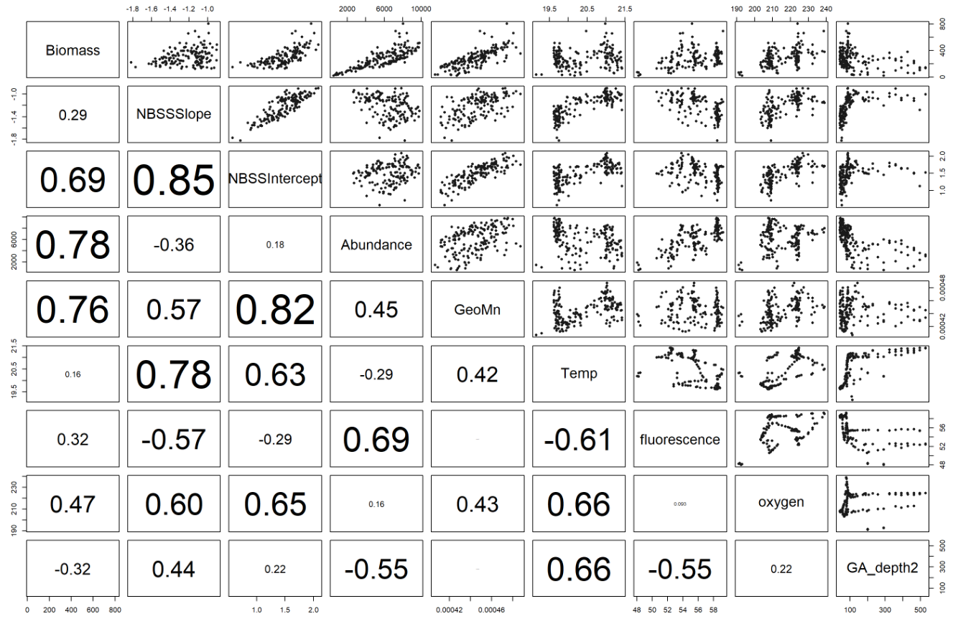
Relationships with y variables @ EH

Slide 12
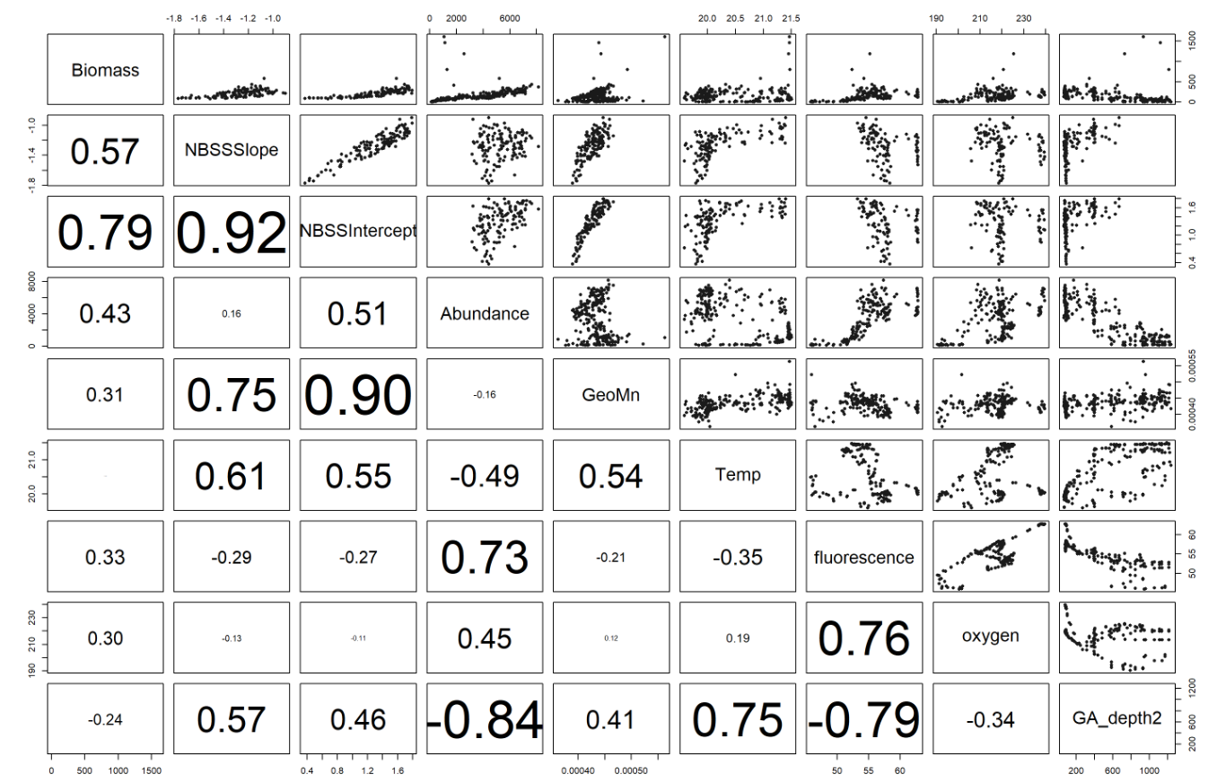
Relationships with y variables @ NS

Slide 13
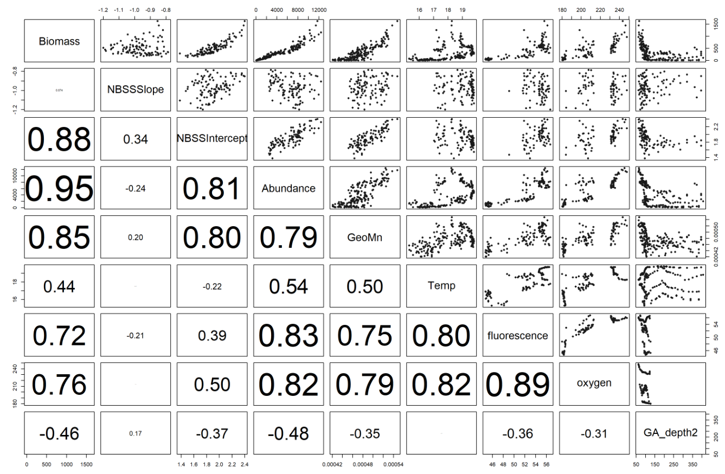
Relationships with y variables @ DH

Slide 14
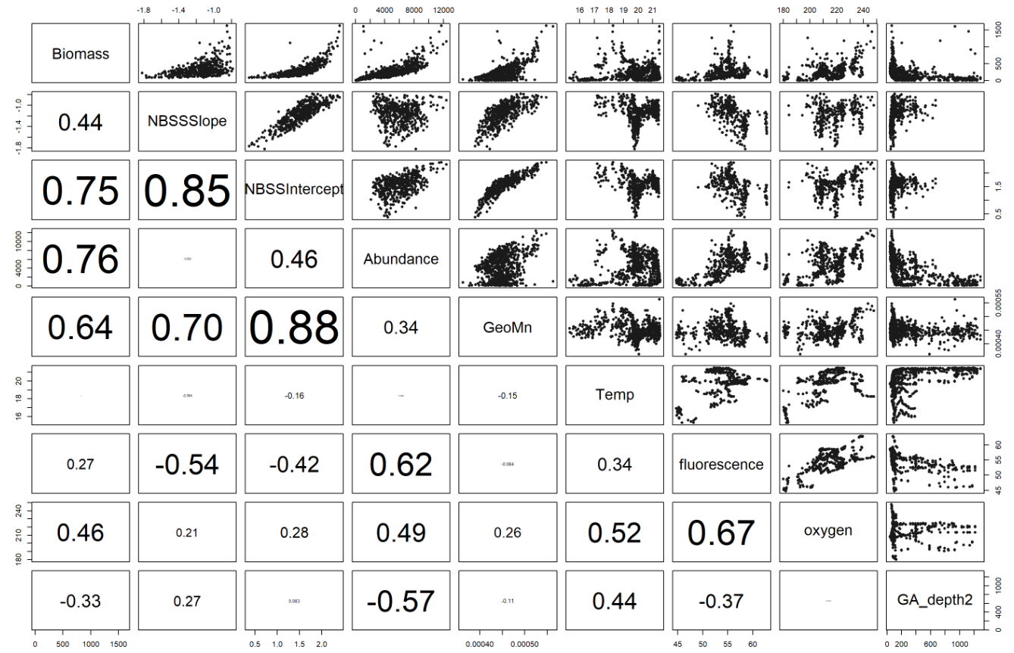
Relationships with y variables @ all sites

Slide 15
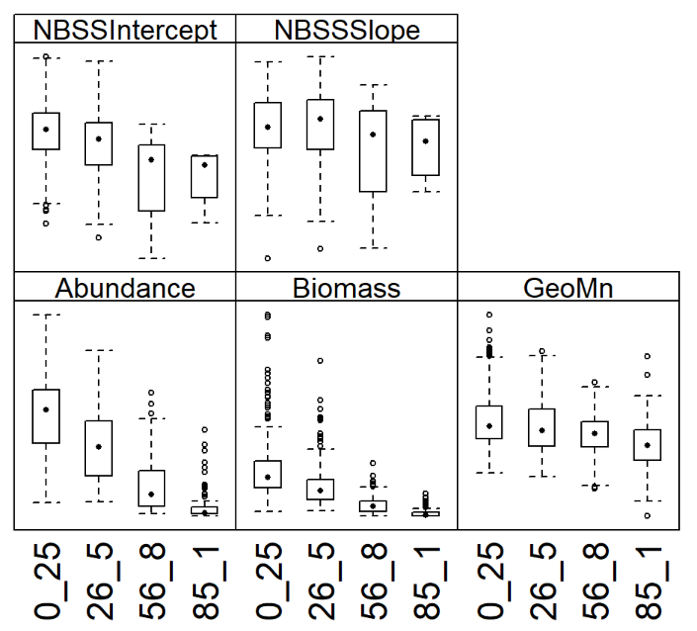
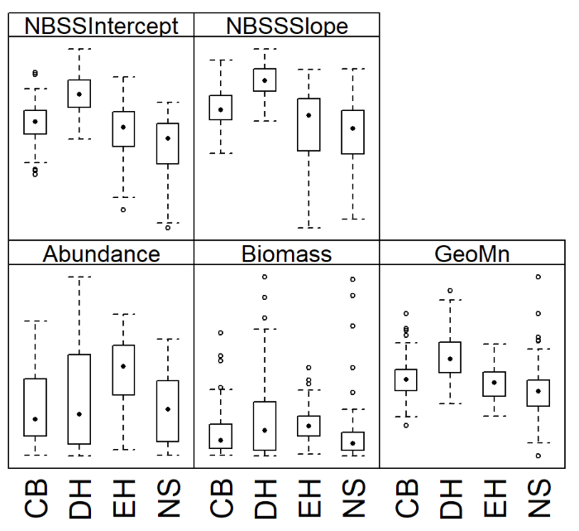
Categorical x versus y
Depth Bin
Site

Slide 16
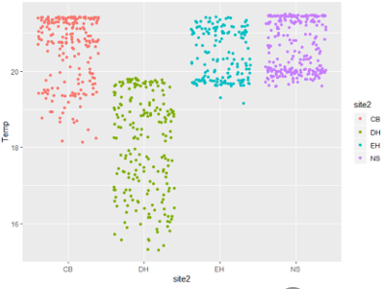
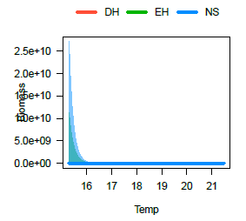
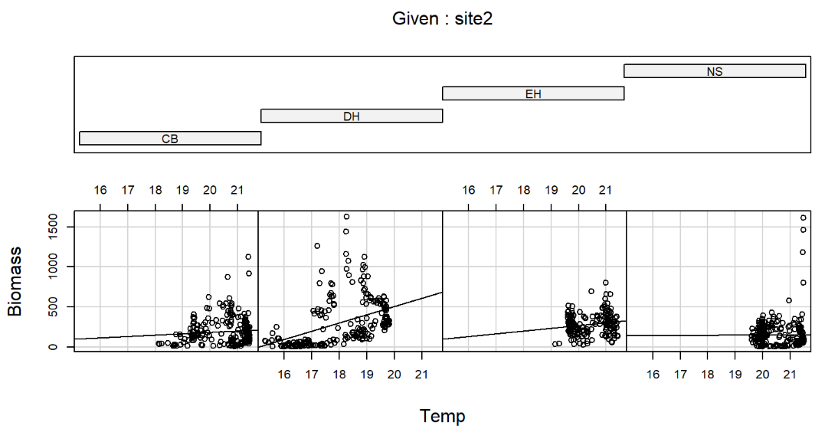
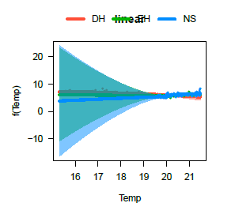
Interactions
Temp
site

Slide 17
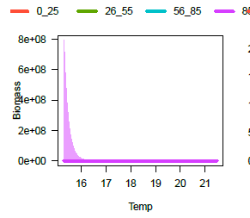
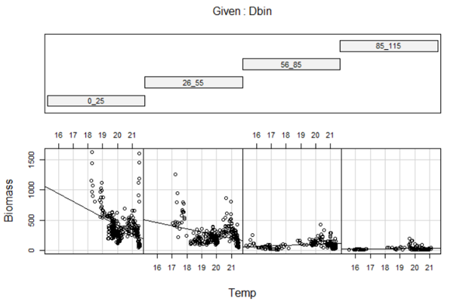
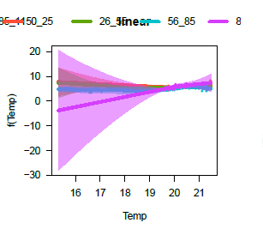
Interactions

Slide 18
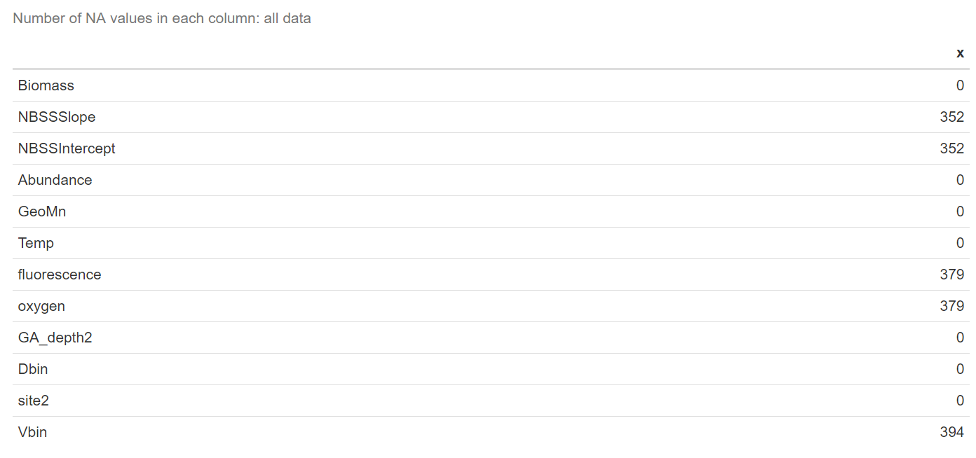
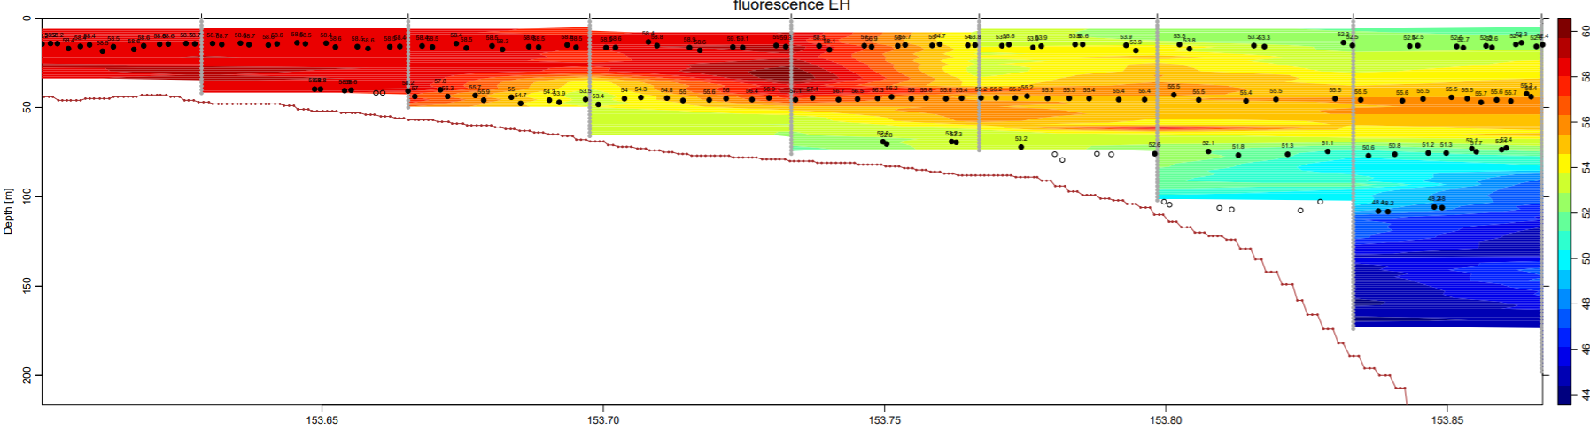
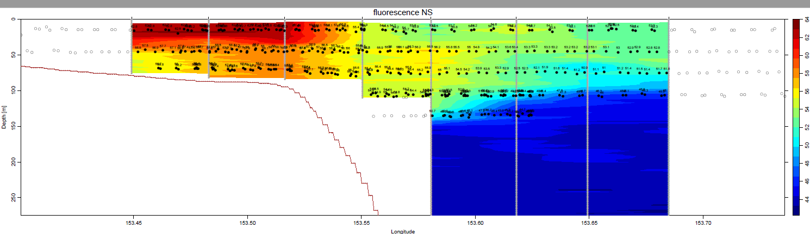
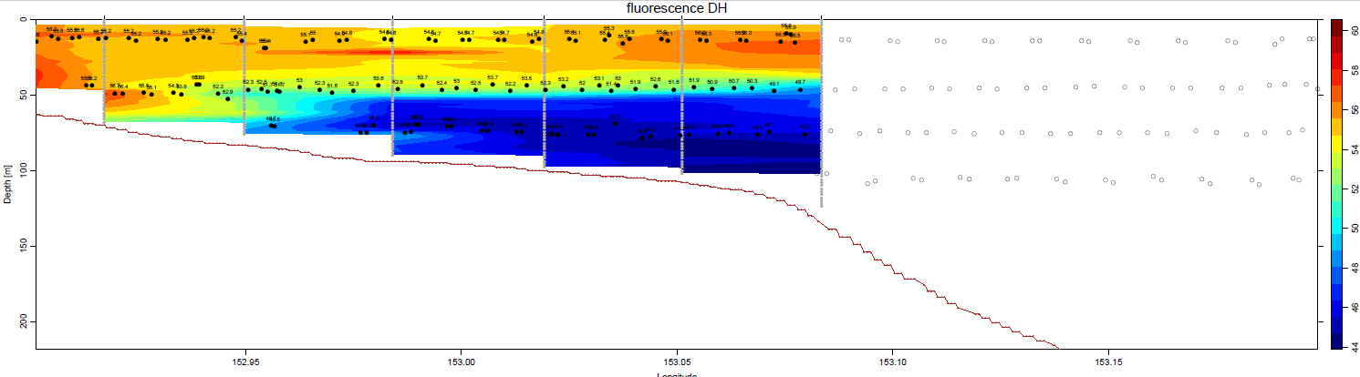

Slide 19
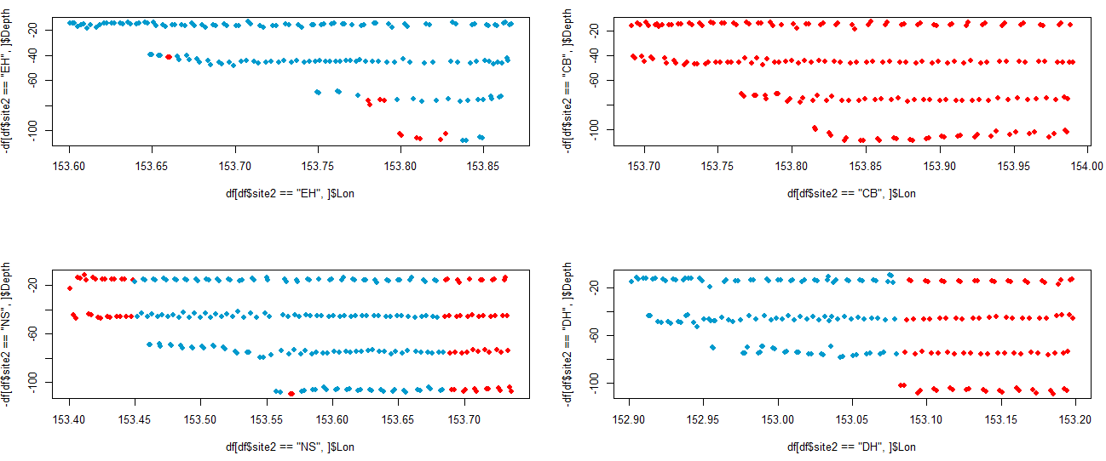
NAs in fluorescence

Slide 20
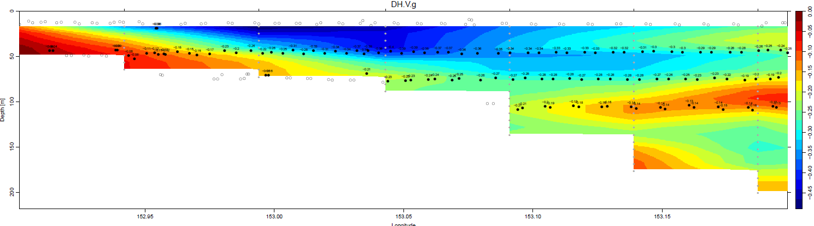
NAs in Vbin

Slide 21
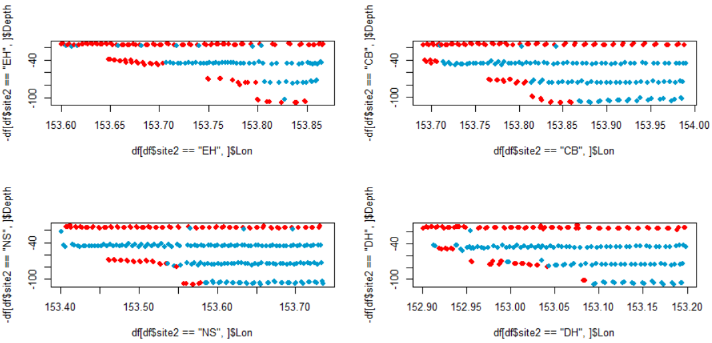
NAs in Vbin

Slide 22
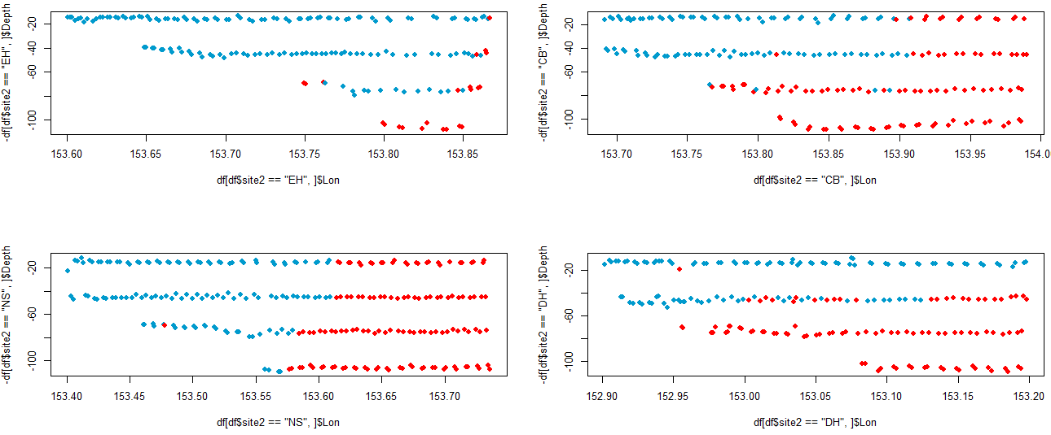
NAs in NBSS slope

Slide 23
Approach
No interactions (?)
Want to keep as much data as possible, although this precludes use of AIC
Present full models (i.e. no model selection)
“the authors of this book prefer to present the full model without prior model selection. The crucial condition is that there be no collinearity. This is most practical for models with fewer than 10 covariates
….this means that we present a model in which some of the covariates may be non-significant” (Zuur et al 2012).
Reminder of what’s left:
Temperature
Fluorescence – has na’s
Bathymetry
Sample depth bin
site
Transect sample depth bin ~ longitude ~ site in spatial correlation term

Slide 24
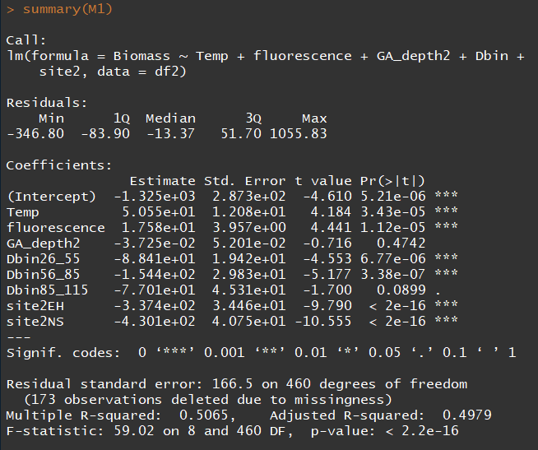
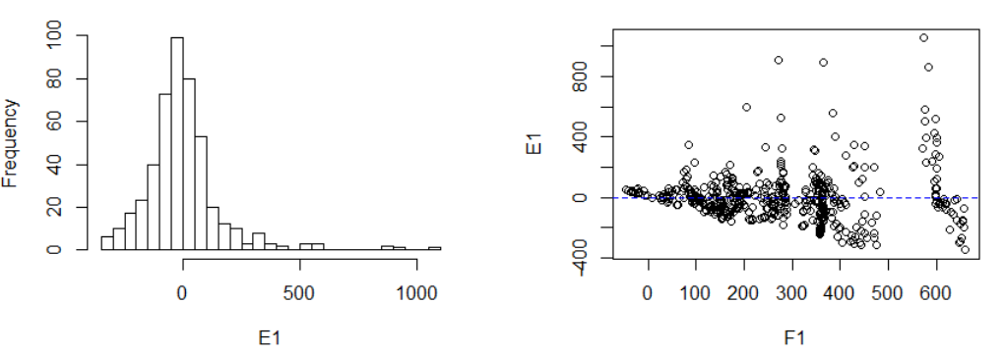
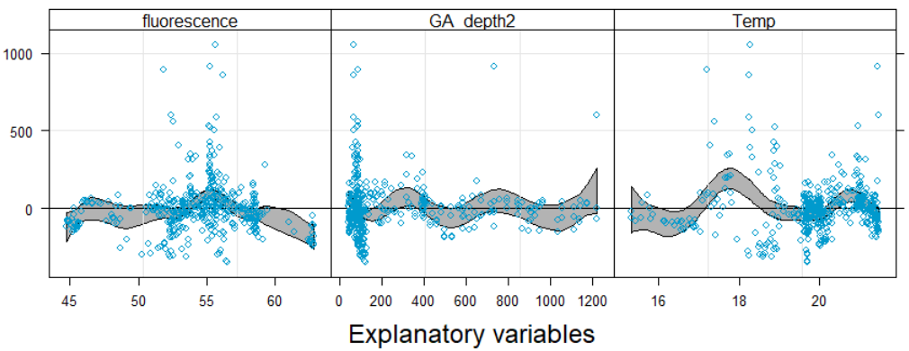
Step1: linear models (biomass example)
M1<- lm(Biomass~Temp+fluorescence+GA_depth2+Dbin+site2, data=df2)
Non-normality, heteroscedasticity, negatived fitted values, non-linear residual patterns

Slide 25
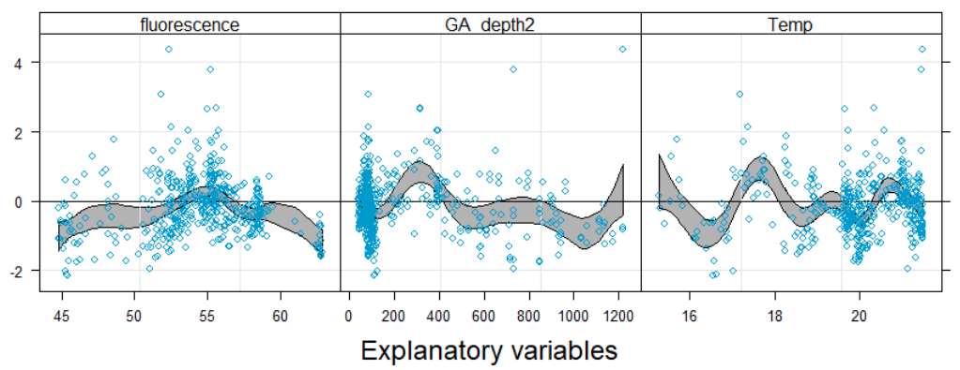
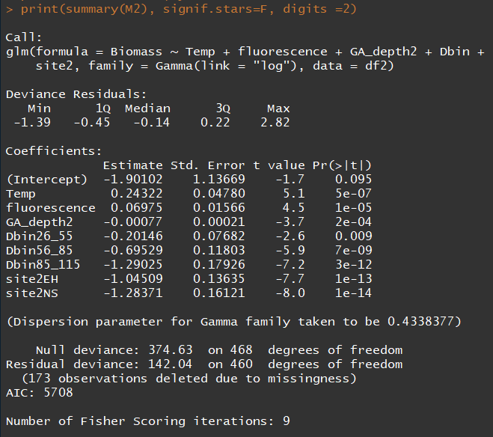
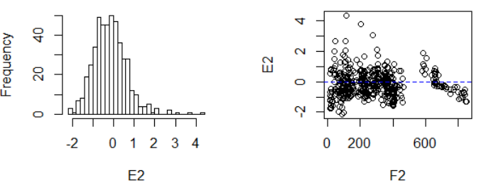
Step2: move to GLM
Gamma distribution for biomass and abundance
Gaussian distribution for NBSS slope and intercept
M2<- glm(Biomass~Temp+fluorescence+GA_depth2+Dbin+site2, data=df2,family=Gamma(link="log"))

Slide 26
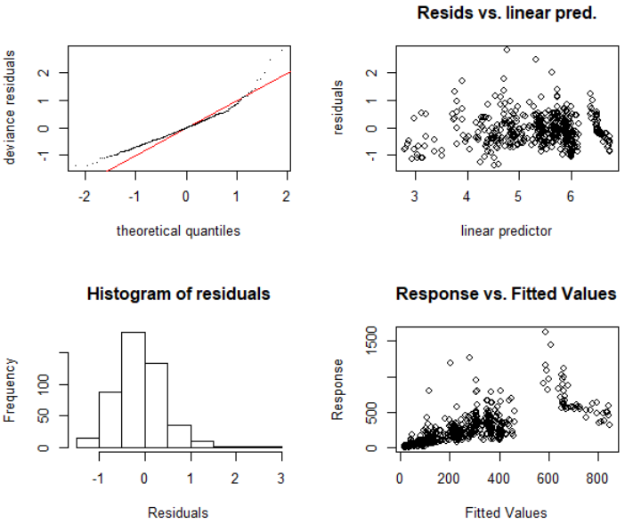
M2 continued

Slide 27
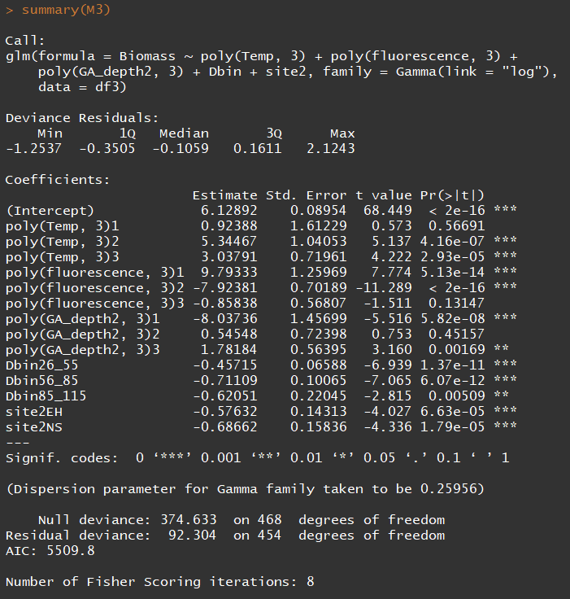
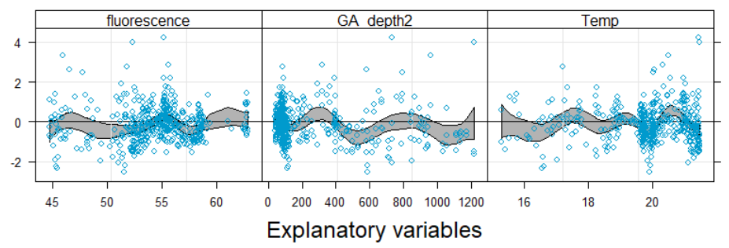
Step 3: try cubic polynomial terms
M3 <- glm(Biomass~poly(Temp,3)+poly(fluorescence,3)+poly(GA_depth2,3)+Dbin+site2, data=df3,family=Gamma(link="log"))

Slide 28
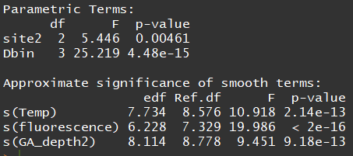
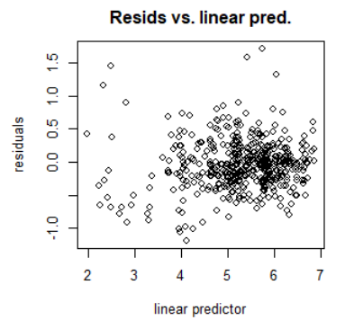
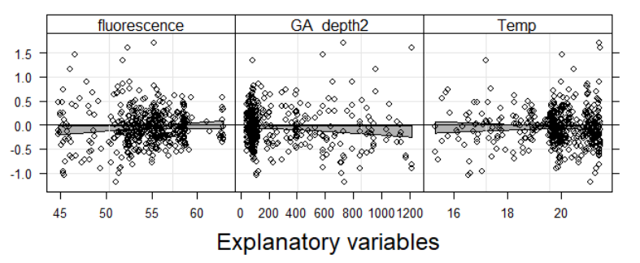
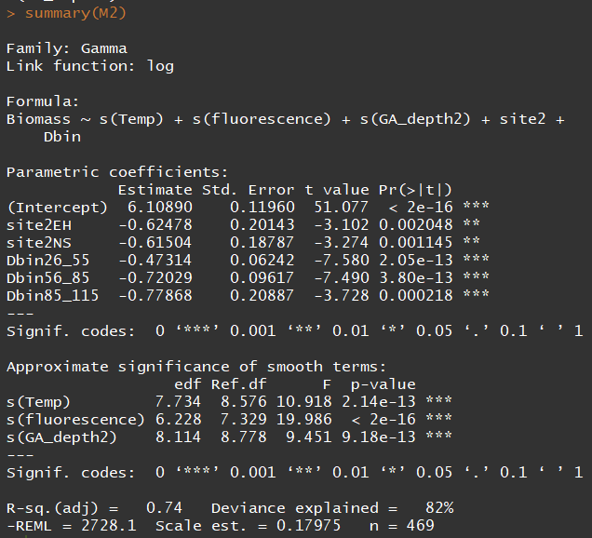
M2 <- gam(Biomass ~ s(Temp) + s(fluorescence) + s(GA_depth2) + site2 + Dbin, data=df3,family=Gamma(link="log"), method="REML")

Slide 29
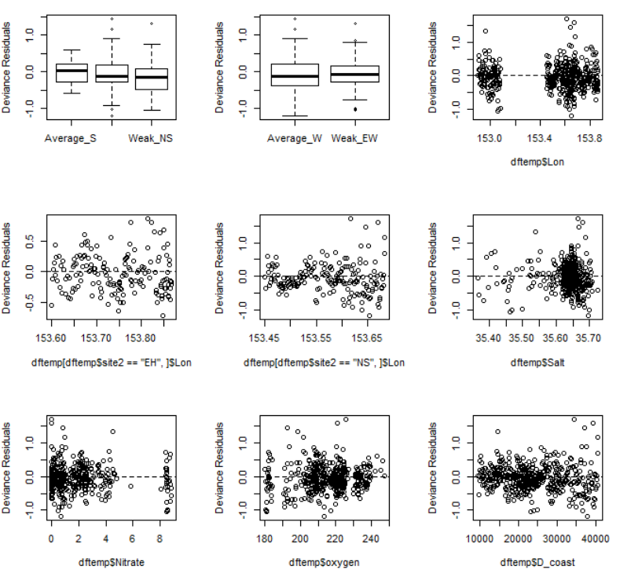
Something is wrong ☺

Slide 30
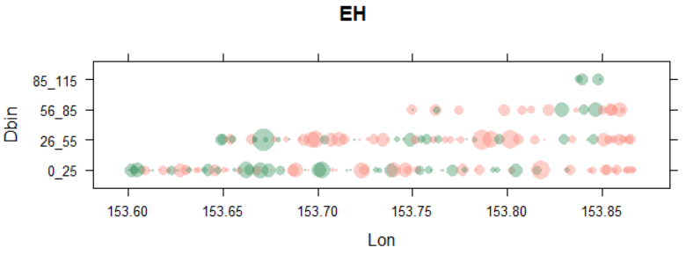
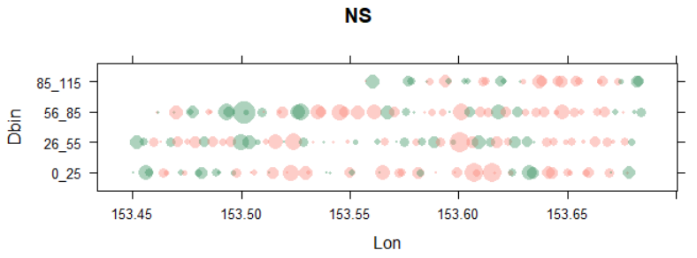
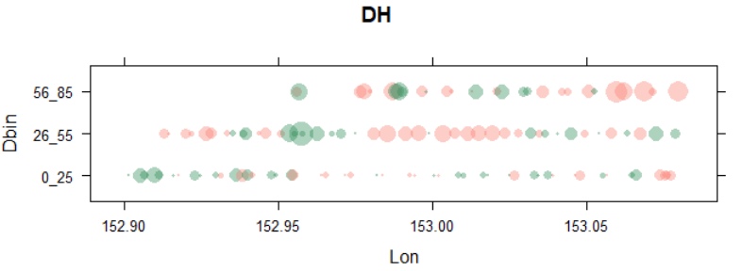
Spatial autocorrelation

Slide 31
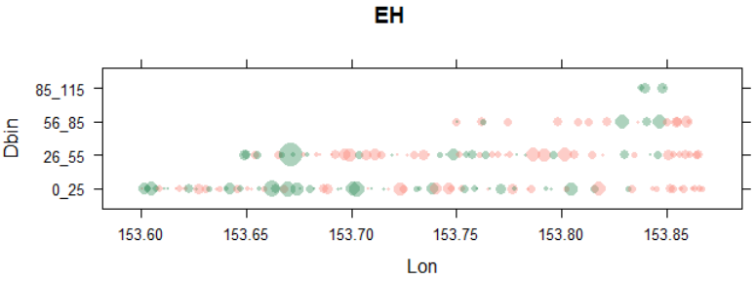



Including a spatial autocorrelation term (working?)
M3 <- gamm(Biomass ~ s(Temp) + s(fluorescence) + s(GA_depth2) + site2 + Dbin, data=df3,family=Gamma(link="log"), method="REML", correlation = corGaus(form = ~ Dbin+Lon| site2))

Slide 32


Gamm with spatial autocorrelation term
Gam without spatial autocorrelation term

Slide 33

Temperature….(over fitted?)
Mgcv does cv for automatic selection of amount of smoothing (df).
Df ~ 1 = straight line, df~10 non-linear.
Explanation of CV on age 49 of Zuur 2012.
Alternatively we can specify different values of k (=df+1)

Slide 34






Is the effect of temperature being hijacked by other variables in the model? (undetected collinearity?)

